Slide 1
SQL ANS

Slide 2
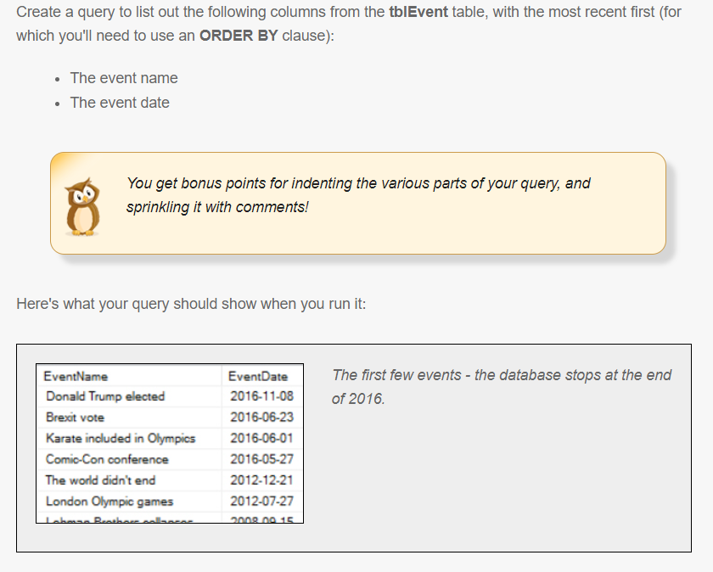
Simple Queries
Question 1

Slide 3
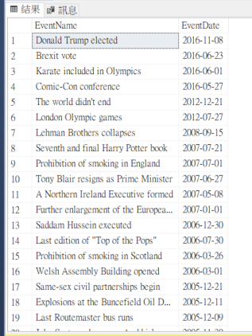
Answer 1
SELECT
e.EventName,
e.EventDate
FROM tblEvent AS e
ORDER BY e.EventDate desc

Slide 4
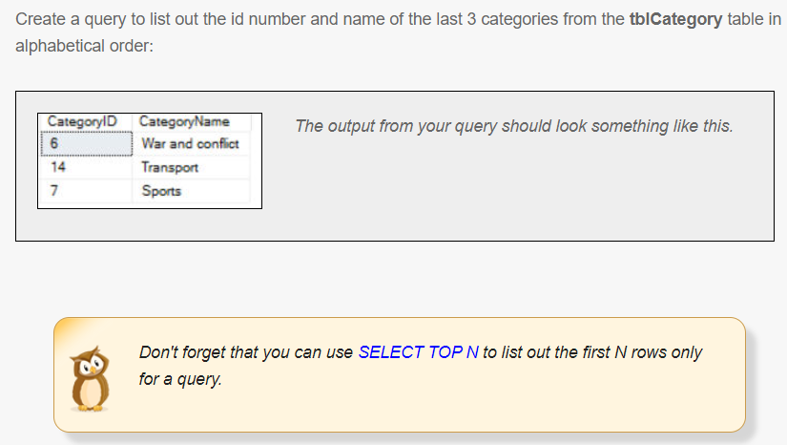
Simple Queries
Question 2

Slide 5
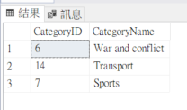
Answer 2
SELECT TOP 3
a.CategoryID,
a.CategoryName
FROM tblCategory AS a
ORDER BY a.CategoryName desc

Slide 6
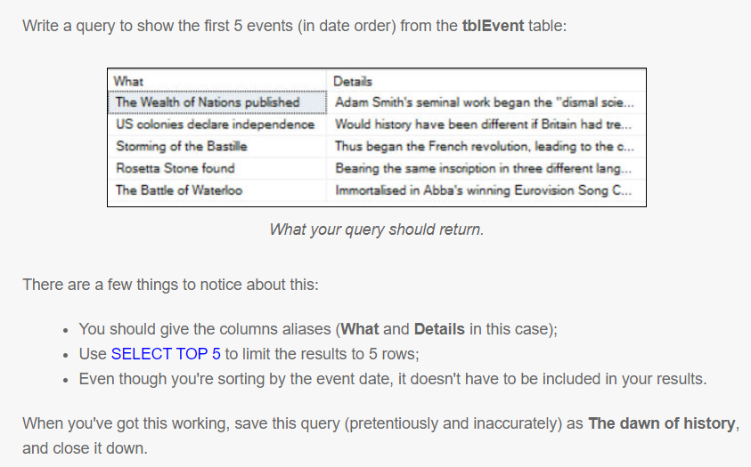
Simple Queries
Question 3

Slide 7
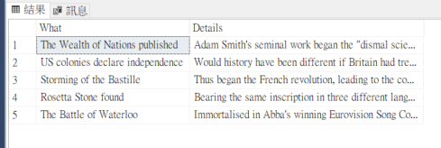
Answer 3
SELECT TOP 5
a.EventName AS 'What',
a.EventDetails AS 'Details'
FROM tblEvent AS a
ORDER BY a.EventDate asc

Slide 8
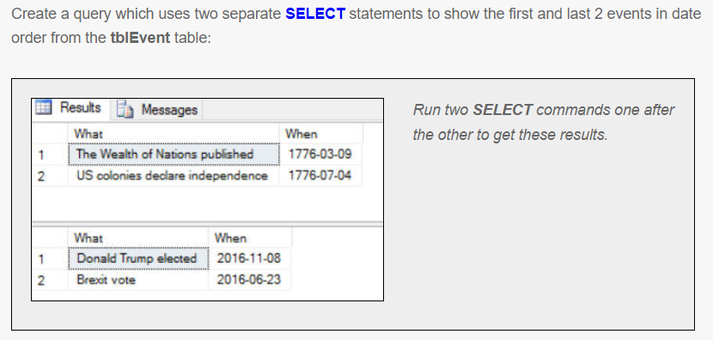
Simple Queries
Question 4

Slide 9
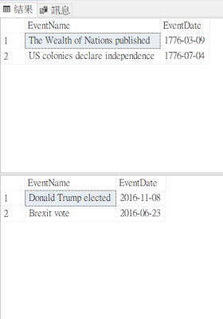
Answer 4
SELECT TOP 2
a.EventName,
a.EventDate
FROM tblEvent AS a
ORDER BY a.EventDate asc
SELECT TOP 2
a.EventName,
a.EventDate
FROM tblEvent AS a
ORDER BY a.EventDate desc

Slide 10
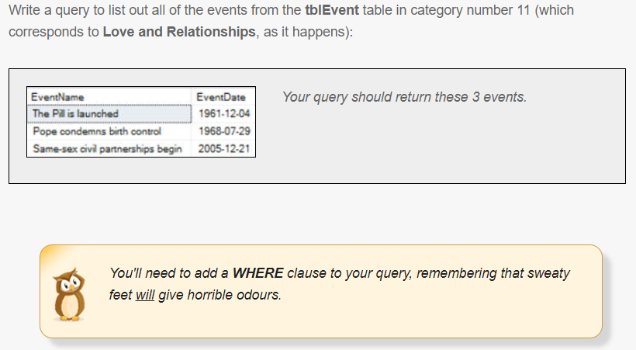
SETTING CRITERIA USING WHERE
Question 1

Slide 11
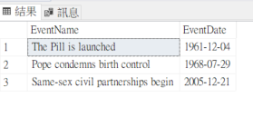
Answer 1
SELECT
a.EventName,
a.EventDate
FROM tblEvent AS a
WHERE a.CategoryID=11
ORDER BY a.CategoryID

Slide 12
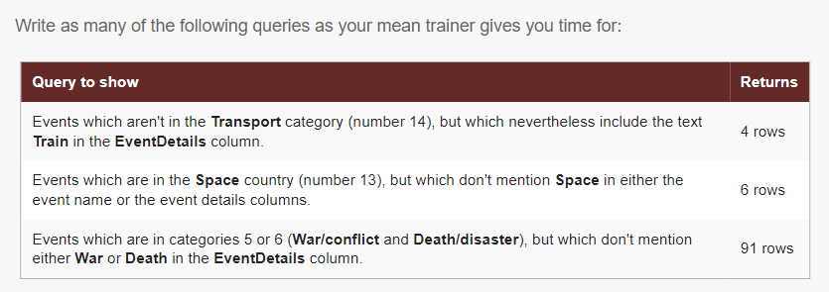
SETTING CRITERIA USING WHERE
Question 2

Slide 13
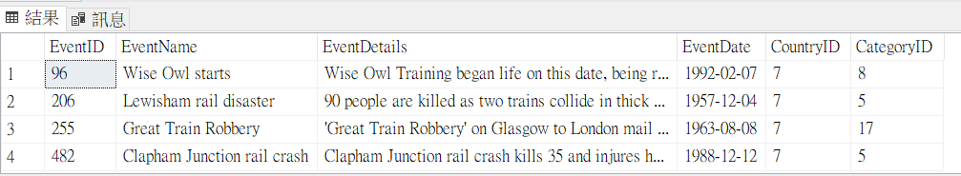
Answer 2
SELECT*
FROM
tblEvent AS e
WHERE
e.CategoryID <> 14 and
(e.EventDetails like '%train%')

Slide 14
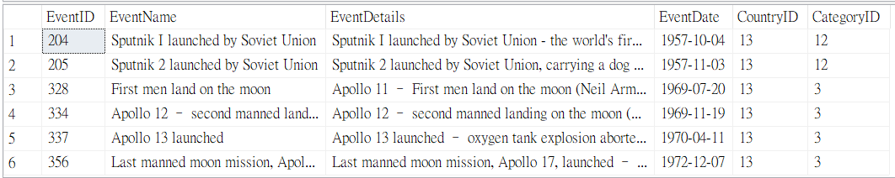
Answer 2
SELECT *
FROM
tblEvent AS a
WHERE
a.CountryID =13 and
a.EventDetails not like '%space%' and
a.EventName not like '%space%'

Slide 15
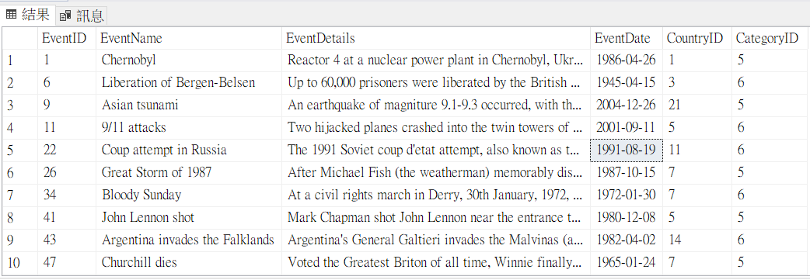
Answer 2
SELECT *
FROM
tblEvent AS a
WHERE
a.CategoryID in (5,6) and
a.EventDetails not like '%War%' and
a.EventDetails not like '%Death%'

Slide 16
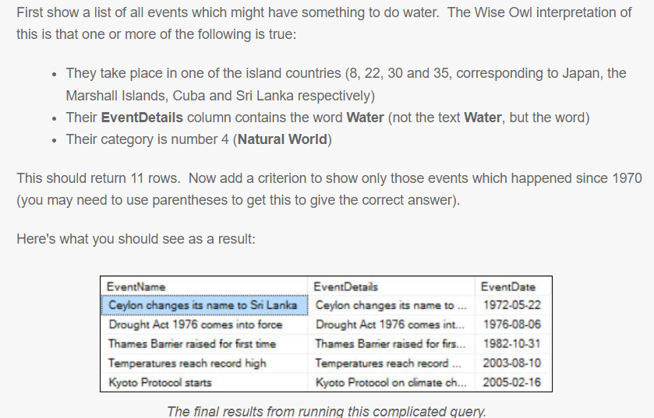
SETTING CRITERIA USING WHERE
Question 3

Slide 17
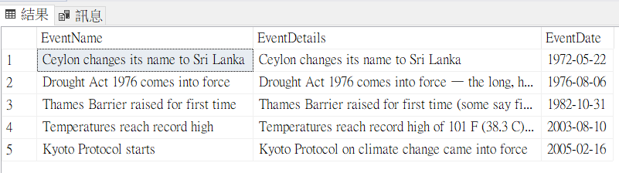
Answer 3
SELECT
a.EventName,
a.EventDetails,
a.EventDate
FROM tblEvent AS a
WHERE
(
a.CountryID IN (8,22,30,35)
or a.EventDetails like '% Water %'
or a.EventDetails like '% Water'
or a.EventDetails like 'Water %'
or a.CategoryID = 4
)
and a.EventDate >= '19700101'

Slide 18
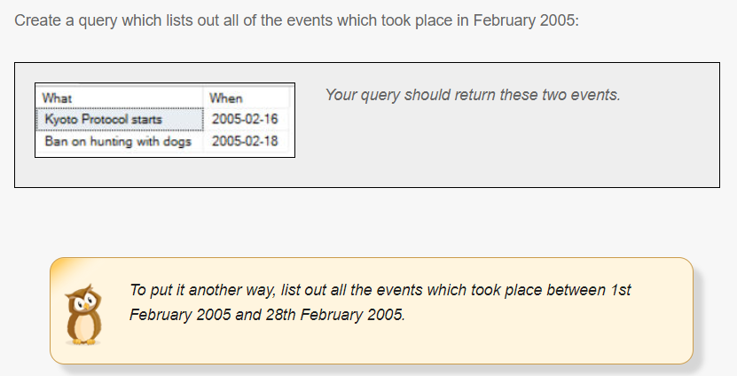
SETTING CRITERIA USING WHERE
Question 4

Slide 19
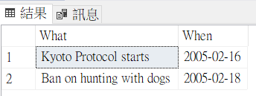
Answer 4
SELECT
a.EventName AS 'What',
a.EventDate AS 'When'
FROM tblEvent AS a
WHERE
a.EventDate between '20050201' and '20050228'

Slide 20
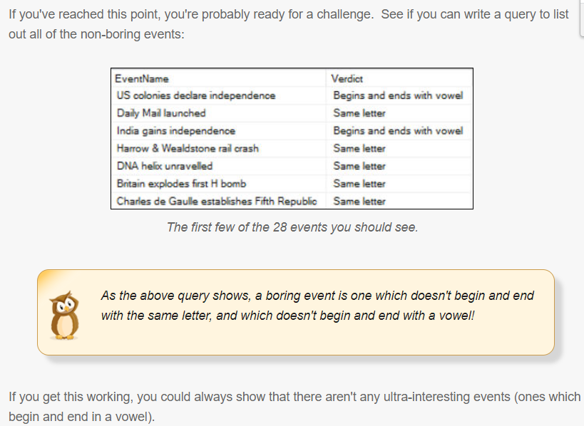
CALCULATIONS
Question 1

Slide 21
Answer 1
SELECT
e.EventName,
CASE
-- this would show events beginning and ending with the same letter, where this is also a vowel
WHEN CHARINDEX(left(e.EventName,1),'aeiou',1)>0 and left(e.EventName,1)=right(e.EventName,1)
THEN 'Same vowel'
-- ones where the left and right letter are the same
WHEN left(e.EventName,1)=right(e.EventName,1)
THEN 'Same letter'

Slide 22
-- ones where both left and right letters are in the string of vowels
WHEN CHARINDEX(left(e.EventName,1),'aeiou',1)>0 and CHARINDEX(right(e.EventName,1),'aeiou',1)>0
THEN 'Begins and ends with vowel'
-- the rest!
ELSE 'Boring event!'
END AS Verdict
FROM tblEvent AS e
WHERE
-- omit the boring ones
CASE
WHEN left(e.EventName,1)=right(e.EventName,1)
THEN 'Same letter'
WHEN CHARINDEX(left(e.EventName,1),'aeiou',1)>0 and CHARINDEX(right(e.EventName,1),'aeiou',1)>0
THEN 'Begins and ends with vowel'
ELSE 'Boring event!'
END <> 'Boring event!'
ORDER BY e.EventDate asc

Slide 23
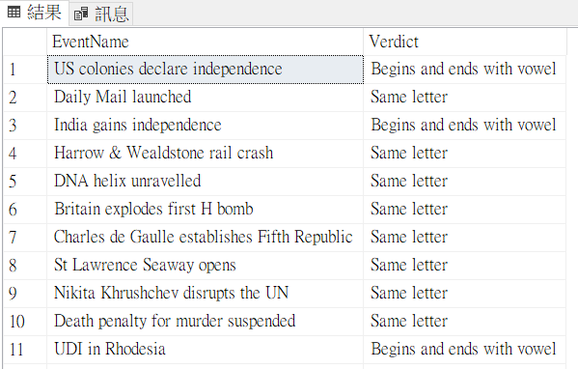

Slide 24
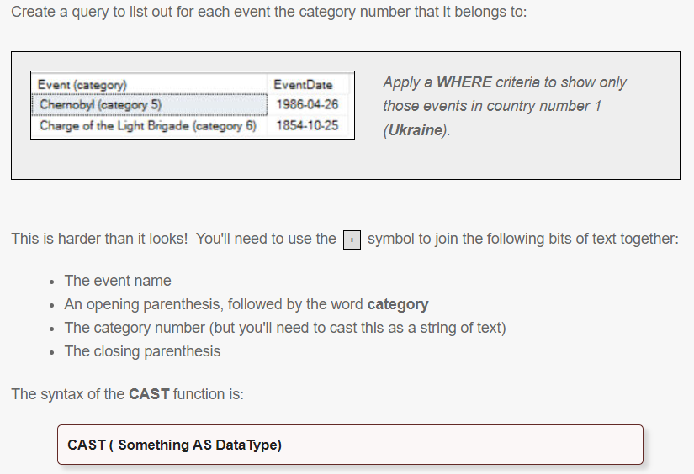
CALCULATIONS
Question 2

Slide 25
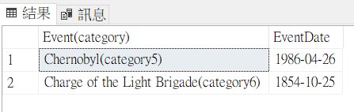
Answer 2
SELECT
a.EventName+
'(category' +
CAST(a.CategoryID AS VARCHAR(100)) +
')' AS 'Event(category)',
a.EventDate
FROM tblEvent AS a
WHERE
a.CountryID=1

Slide 26
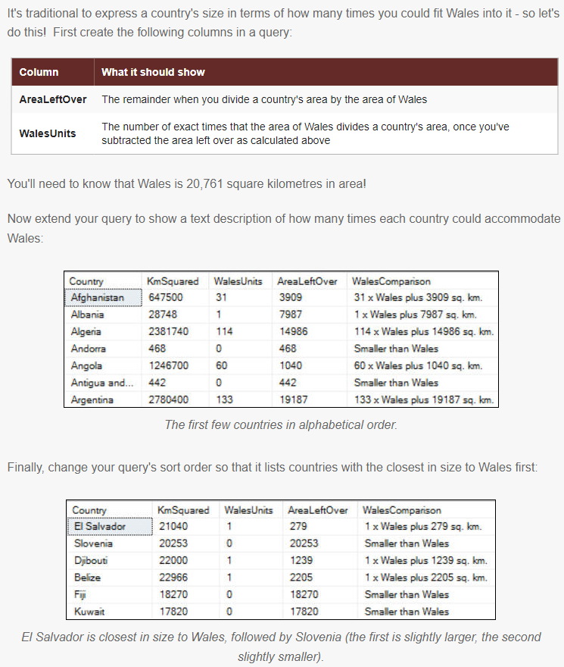
CALCULATIONS
Question 3

Slide 27
Answer 3
SELECT
c.Country,
c.KmSquared,
(c.KmSquared-c.KmSquared % 20761)/20761 AS WalesUnits,
c.KmSquared % 20761 AS AreaLeftOver,
CASE
WHEN c.KmSquared < 20761 THEN 'Smaller than Wales'
ELSE CAST((c.KmSquared-c.KmSquared % 20761)/20761 as varchar(100)) +'x Wales plus '
+ CAST((c.KmSquared % 20761)as varchar(100))
+'sq. km.'
END AS WalesComparison
FROM CountriesByArea AS c
ORDER BY ABS(20761-c.KmSquared) ASC

Slide 28
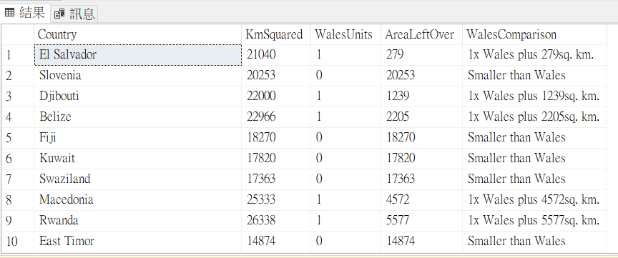

Slide 29
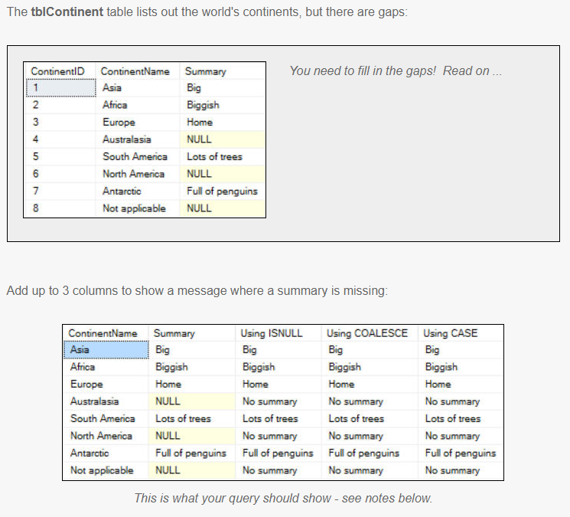
CALCULATIONS
Question 4

Slide 30
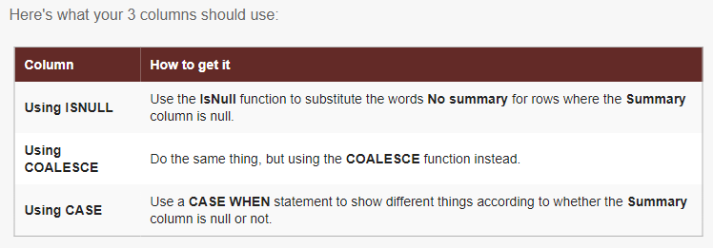

Slide 31
Answer 4
SELECT
t.ContinentName,
t.Summary,
--Using ISNULL
ISNULL(t.Summary,'No summary') AS 'Using ISNULL',
--Using COALESCE
COALESCE(t.Summary,'No summary') AS 'Using COALESCE',
--Using CASE
CASE
WHEN t.Summary is null THEN 'No summary'
ELSE t.Summary
END AS 'Using CASE'
FROM tblContinent as t

Slide 32
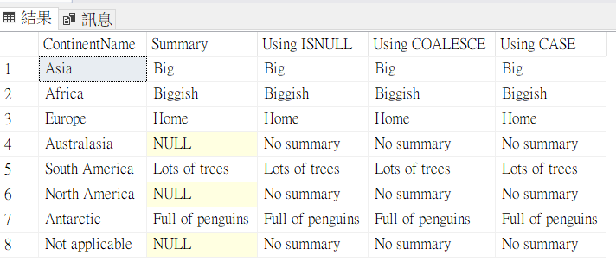

Slide 33
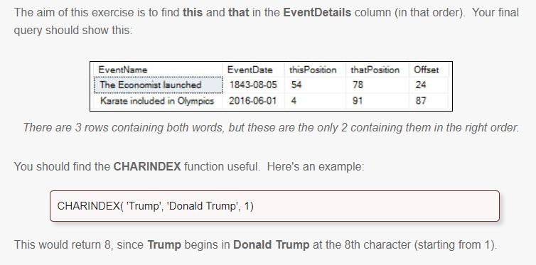
CALCULATIONS
Question 5

Slide 34
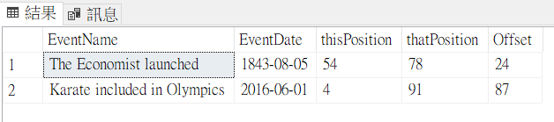
Answer 5
SELECT
t.EventName,
t.EventDate,
CHARINDEX('this',t.EventDetails) AS thisPosition,
CHARINDEX('that',t.EventDetails) AS thatPosition,
CHARINDEX('that',t.EventDetails)-CHARINDEX('this',t.EventDetails) AS Offset
FROM tblEvent AS t
WHERE
CHARINDEX('this',t.EventDetails) > 0 and
CHARINDEX('that',t.EventDetails) > 0 and
CHARINDEX('that',t.EventDetails)-CHARINDEX('this',t.EventDetails) > 0

Slide 35
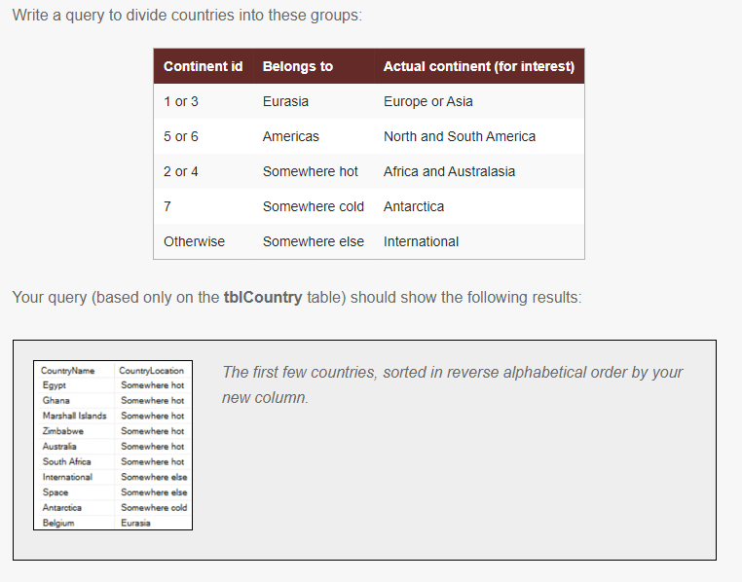
CALCULATIONS
Question 6

Slide 36
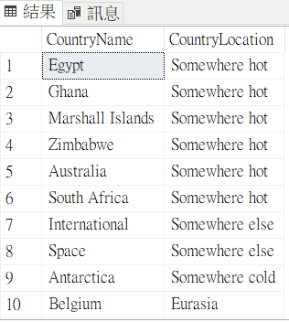
Answer 6
SELECT
t.CountryName,
CASE
WHEN t.ContinentID in (1,3) THEN 'Eurasia'
WHEN t.ContinentID in (5,6) THEN 'Americas'
WHEN t.ContinentID in (2,4) THEN 'Somewhere hot'
WHEN t.ContinentID = 7 THEN 'Somewhere cold'
ELSE 'Somewhere else'
END AS CountryLocation
FROM tblCountry t
ORDER BY CountryLocation desc

Slide 37
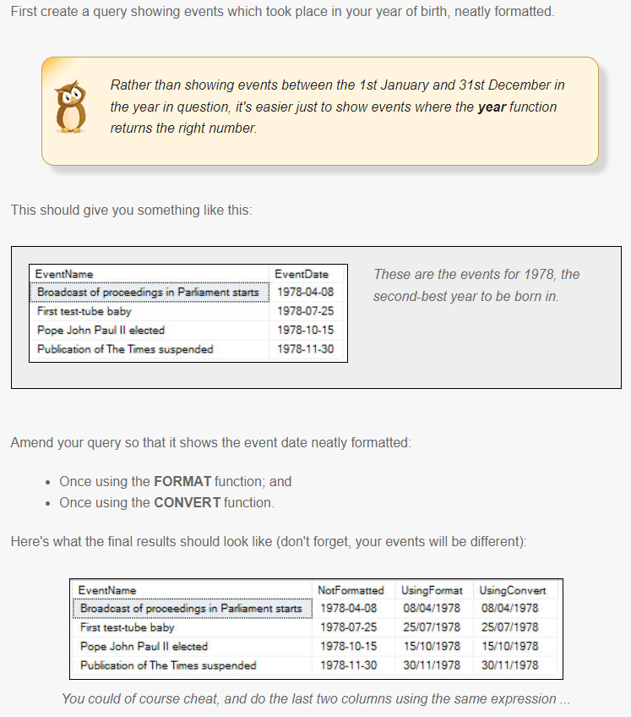
CALCULATIONS USING DATES
Question 1

Slide 38
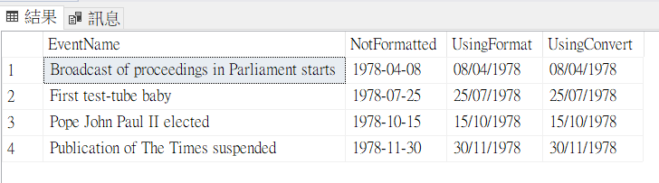
Answer 1
SELECT
e.EventName,
e.EventDate AS NotFormatted,
FORMAT(e.EventDate, 'dd/MM/yyyy' ) AS UsingFormat,
CONVERT(NVARCHAR(10),e.EventDate,103 ) AS UsingConvert
FROM
tblEvent AS e
WHERE
year(e.EventDate) = 1978
ORDER BY e.EventDate asc

Slide 39
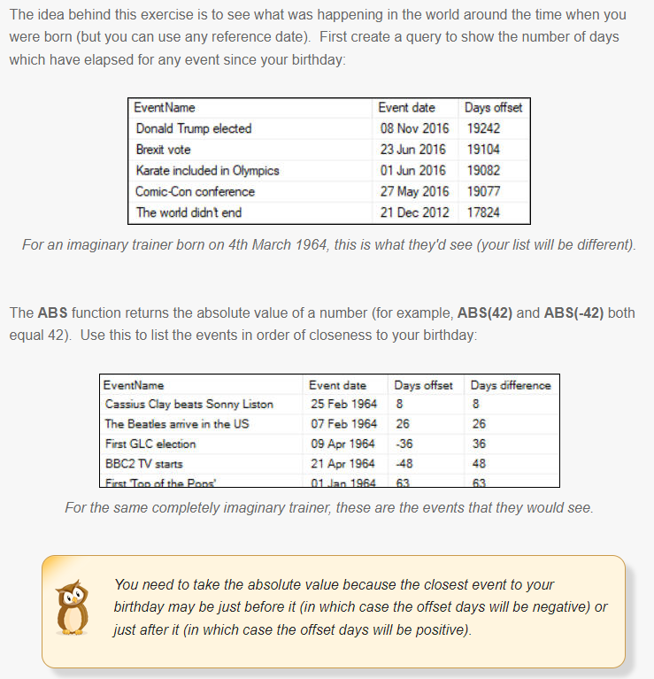
CALCULATIONS USING DATES
Question 2

Slide 40
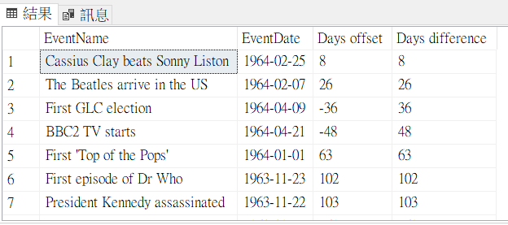
Answer 2
SELECT
t.EventName,
t.EventDate,
DATEDIFF(day,t.EventDate,'19640304') AS 'Days offset',
ABS(DATEDIFF(day,t.EventDate,'19640304')) AS 'Days difference'
FROM tblEvent AS t
ORDER BY 'Days difference' asc

Slide 41
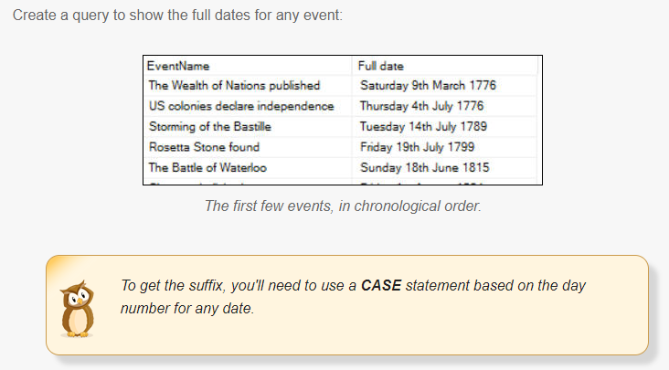
CALCULATIONS USING DATES
Question 3

Slide 42
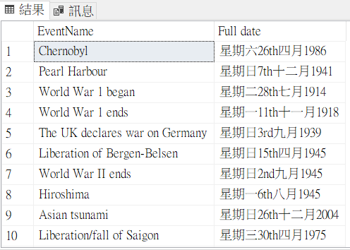
Answer 3
SELECT
t.EventName,
DATENAME(weekday,t.EventDate)+
DATENAME(day,t.EventDate)+
CASE
WHEN DATEPART(day,t.EventDate) IN (1,21,31) THEN 'st'
WHEN DATEPART(day,t.EventDate) IN (2,22) THEN 'nd'
WHEN DATEPART(day,t.EventDate) IN (3,23) THEN 'rd'
ELSE 'th'
END +
DATENAME(month,t.EventDate)+
DATENAME(year,t.EventDate)
AS 'Full date'
FROM tblEvent AS t

Slide 43
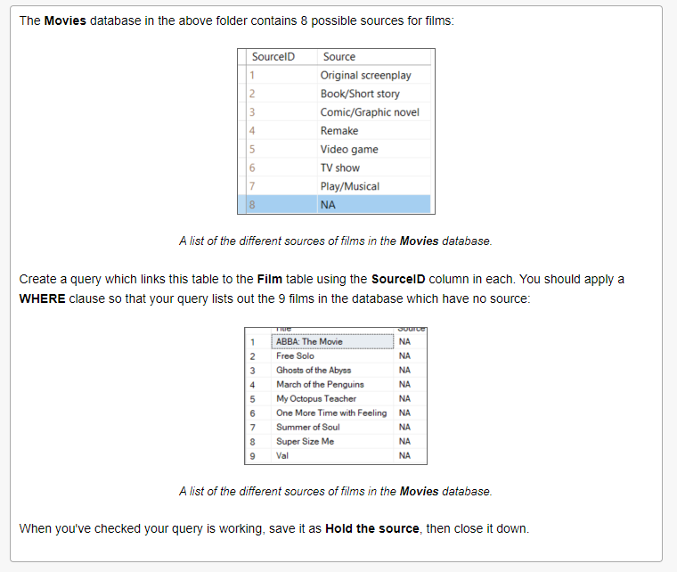
BASIC JOINS
Question 1

Slide 44
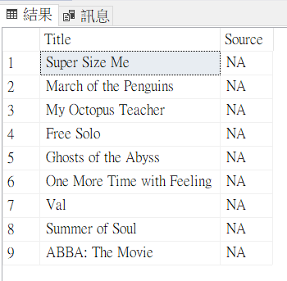
Answer 1
SELECT
f.Title,
s.Source
FROM
Film as f
JOIN Source AS s ON s.SourceID=f.SourceID
WHERE
s.Source='NA'

Slide 45
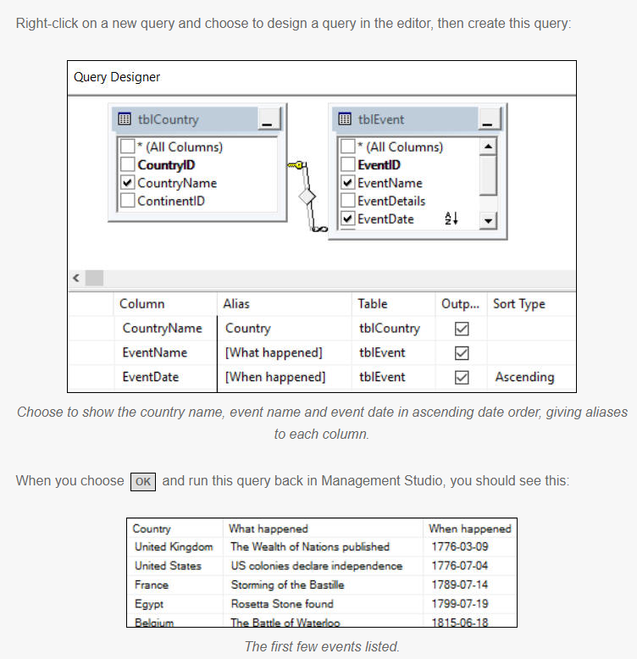
BASIC JOINS
Question 2

Slide 46
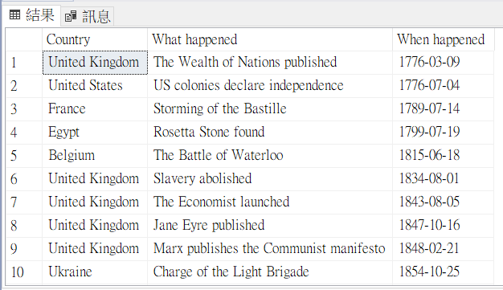
Answer 2
SELECT
tblCountry.CountryName AS Country,
tblEvent.EventName AS [What happened],
tblEvent.EventDate AS [When happened]
FROM
tblCountry
INNER JOIN tblEvent
ON tblCountry.CountryID = tblEvent.CountryID
ORDER BY
[When happened]

Slide 47
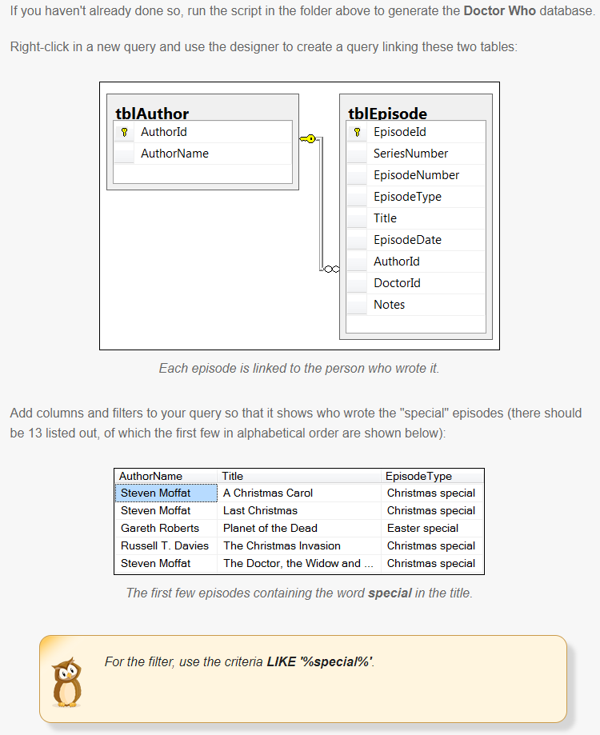
BASIC JOINS
Question 3

Slide 48
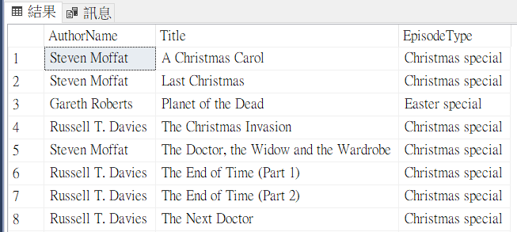
Answer 3
SELECT
tblAuthor.AuthorName,
tblEpisode.Title,
tblEpisode.EpisodeType
FROM
tblAuthor
INNER JOIN tblEpisode ON
tblAuthor.AuthorId = tblEpisode.AuthorId
WHERE
tblEpisode.EpisodeType LIKE '%special%'
ORDER BY
tblEpisode.Title

Slide 49
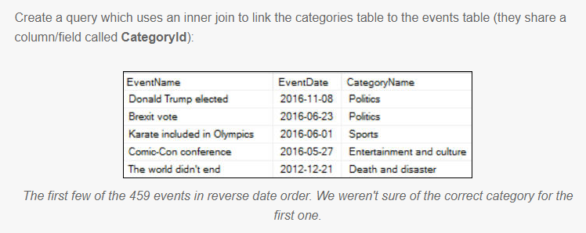
BASIC JOINS
Question 4

Slide 50
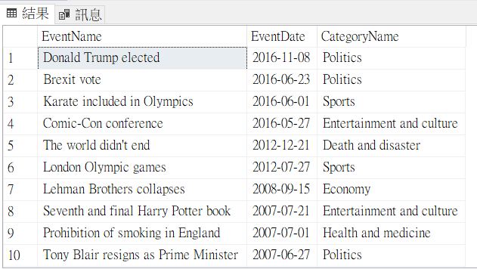
SELECT
tblEvent.EventName,
tblEvent.EventDate,
tblCategory.CategoryName
FROM
tblEvent
INNER JOIN tblCategory ON
tblEvent.CategoryID = tblCategory.CategoryID
ORDER BY
tblEvent.EventDate desc

Slide 51
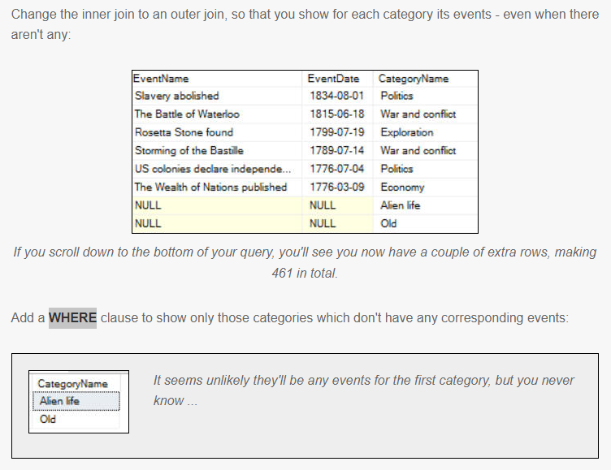

Slide 52
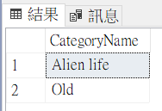
Answer 4
SELECT
tblCategory.CategoryName
FROM
tblEvent
RIGHT OUTER JOIN tblCategory ON
tblEvent.CategoryID = tblCategory.CategoryID
WHERE
tblEvent.EventID is null
ORDER BY
tblEvent.EventDate desc

Slide 53
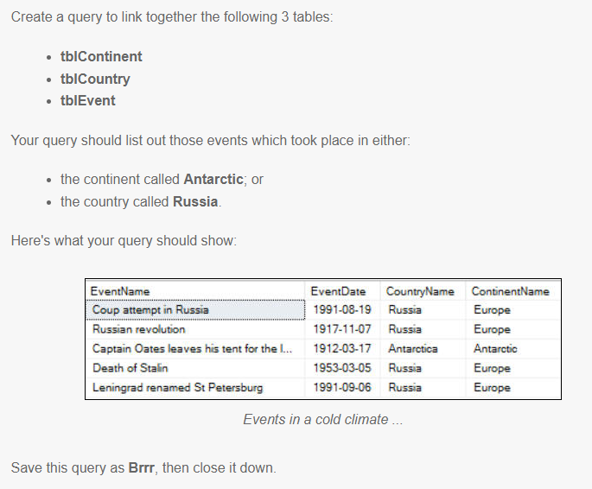
BASIC JOINS
Question 5

Slide 54
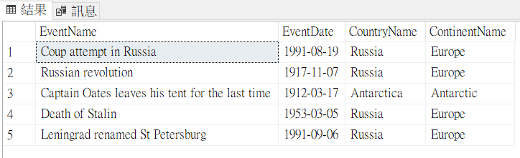
Answer 5
SELECT
e.EventName,
e.EventDate,
t.CountryName,
c.ContinentName
FROM
tblCountry AS t
INNER JOIN tblContinent AS c ON
t.ContinentID = c.ContinentID
INNER JOIN tblEvent AS e ON
t.CountryID = e.CountryID
WHERE
c.ContinentName='Antarctic' or
t.CountryName='Russia'

Slide 55
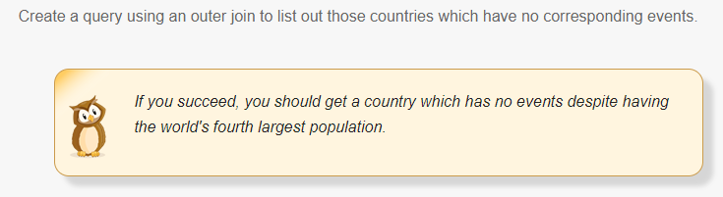
BASIC JOINS
Question 6

Slide 56

Answer 6
SELECT
c.CountryName
FROM
tblCountry AS c
LEFT OUTER JOIN tblEvent AS e ON
c.CountryID = e.CountryID
WHERE
e.EventName is null

Slide 57

BASIC JOINS
Question 7

Slide 58

Answer 7
SELECT
a.AuthorName,
e.Title,
d.DoctorName,
en.EnemyName,
len(a.AuthorName)+len(e.Title)+len(d.DoctorName)+len(en.EnemyName) AS 'Total length'
FROM
tblEpisode AS e
--lots of JOIN
INNER JOIN tblAuthor AS a ON
e.AuthorId = a.AuthorId
INNER JOIN tblDoctor AS d ON
e.DoctorId = d.DoctorId
INNER JOIN tblEpisodeEnemy AS ee ON
e.EpisodeId = ee.EpisodeId
INNER JOIN tblEnemy AS en ON
ee.EnemyId = en.EnemyId
WHERE
len(a.AuthorName)+len(e.Title)+len(d.DoctorName)+len(en.EnemyName) < 40

Slide 59

More exotic joins
Question 1

Slide 60

Answer 1
SELECT
c.CompanionName
FROM
tblCompanion AS c
LEFT OUTER JOIN tblEpisodeCompanion AS ec
ON c.CompanionId = ec.CompanionId
WHERE
ec.EpisodeCompanionId is null

Slide 61

Aggregation and grouping
Question 1

Slide 62

Answer 1
SELECT
COUNT(t.EventID) AS 'Number of events',
MAX(t.EventDate) AS 'Last date',
MIN(t.EventDate) AS 'First date'
FROM
tblEvent AS t

Slide 63

Aggregation and grouping
Question 2

Slide 64

Answer 2
SELECT
c.CategoryName,
COUNT(*) AS 'Number of events'
FROM
tblCategory AS c
INNER JOIN tblEvent AS e
ON c.CategoryID = e.CategoryID
GROUP BY c.CategoryName
ORDER BY 'Number of events' DESC

Slide 65


Aggregation and grouping
Question 3

Slide 66

Answer 3
SELECT
a.AuthorName,
COUNT(*) AS Episodes,
MIN(e.EpisodeDate) AS 'Earliest date',
MAX(e.EpisodeDate) AS 'Latest date'
FROM
tblAuthor AS a
INNER JOIN tblEpisode AS e
ON a.AuthorId = e.AuthorId
GROUP BY a.AuthorName
ORDER BY Episodes DESC

Slide 67


Aggregation and grouping
Question 4

Slide 68

Answer 4
SELECT
a.AuthorName,
d.DoctorName,
COUNT(*) AS Episodes
FROM
tblAuthor AS a
INNER JOIN tblEpisode AS e
ON a.AuthorId = e.AuthorId
INNER JOIN tblDoctor AS d
ON e.DoctorId = d.DoctorId
GROUP BY
a.AuthorName,
d.DoctorName
HAVING
COUNT(*) > 5
ORDER BY Episodes DESC

Slide 69


Aggregation and grouping
Question 5

Slide 70

Answer 5
SELECT
c1.ContinentName AS Continent,
c2.CountryName as Country,
COUNT(*) AS 'Number of events'
FROM
tblContinent AS c1
inner join tblCountry AS c2
ON c1.ContinentID = c2.ContinentID
inner join tblEvent AS e
ON c2.CountryID = e.CountryID
WHERE
c1.ContinentName <> 'Europe'
GROUP BY
c2.CountryName,
c1.ContinentName
HAVING
Count(*)>5
ORDER BY
Country ASC

Slide 71

Aggregation and grouping
Question 6

Slide 72

Answer 6
SELECT
UPPER(LEFT(c.CategoryName,1)) AS 'Category initial',
COUNT(*) AS 'Number of events',
FORMAT(AVG(CONVERT(FLOAT,LEN(e.EventName))),'0.00') AS 'Average event name length'
FROM
tblCategory AS c
INNER JOIN tblEvent AS e
ON c.CategoryID = e.CategoryID
GROUP BY
UPPER(LEFT(c.CategoryName,1))
ORDER BY
'Category initial'

Slide 73

Aggregation and grouping
Question 7

Slide 74

Answer 7
SELECT
CASE
WHEN YEAR(e.EventDate) < 1800 THEN '18th century'
WHEN YEAR(e.EventDate) < 1900 THEN '19th century'
WHEN YEAR(e.EventDate) < 2000 THEN '20th century'
ELSE '21st century'
END AS Century,
COUNT(*) AS 'Number events'
FROM
tblEvent AS e
GROUP BY
--CUBE shows the grand total
CUBE
(CASE
WHEN YEAR(e.EventDate) < 1800 THEN '18th century'
WHEN YEAR(e.EventDate) < 1900 THEN '19th century'
WHEN YEAR(e.EventDate) < 2000 THEN '20th century'
ELSE '21st century'
END )
ORDER BY Century

Slide 75

Aggregation and grouping
Question 8

Slide 76

Answer 8
SELECT
YEAR(e.EpisodeDate) AS 'Episode year',
en.EnemyName AS EnemyName,
COUNT(*) AS 'Number of episodes'
FROM
tblDoctor AS d
INNER JOIN tblEpisode AS e
ON d.DoctorId = e.DoctorId
INNER JOIN tblEpisodeEnemy AS ee
ON ee.EpisodeId = e.EpisodeId
INNER JOIN tblEnemy AS en
ON en.EnemyId = ee.EnemyId
WHERE
YEAR(d.BirthDate) < 1970
GROUP BY
en.EnemyName,
YEAR(e.EpisodeDate)
HAVING
COUNT(*) > 1
ORDER BY
'Number of episodes' DESC

Slide 77


Views
Question 1

Slide 78

Answer 1
USE [DoctorWho]
GO
SET ANSI_NULLS ON
GO
SET QUOTED_IDENTIFIER ON
GO

Slide 79

ALTER VIEW [dbo].[vwEpisodesByFirstLetter]
AS
SELECT TOP (100) PERCENT dbo.tblAuthor.AuthorName, dbo.tblDoctor.DoctorName, dbo.tblEpisode.Title, dbo.tblEpisode.EpisodeDate
FROM dbo.tblAuthor INNER JOIN
dbo.tblEpisode ON dbo.tblAuthor.AuthorId = dbo.tblEpisode.AuthorId INNER JOIN
dbo.tblDoctor ON dbo.tblEpisode.DoctorId = dbo.tblDoctor.DoctorId
WHERE (dbo.tblEpisode.Title LIKE N'H%')
ORDER BY dbo.tblEpisode.EpisodeDate DESC
GO
SELECT *
FROM [dbo].[vwEpisodesByFirstLetter]

Slide 80


Views
Question 2

Slide 81



Slide 82

Answer 2
USE [WorldEvents]
GO
SET ANSI_NULLS ON
GO
SET QUOTED_IDENTIFIER ON
GO
ALTER VIEW [dbo].[EventsByCategory]
AS
SELECT TOP (100) PERCENT dbo.tblCategory.CategoryName AS Category, COUNT(dbo.tblEvent.EventName) AS What
FROM dbo.tblCategory INNER JOIN
dbo.tblEvent ON dbo.tblCategory.CategoryID = dbo.tblEvent.CategoryID
GROUP BY dbo.tblCategory.CategoryName
ORDER BY What DESC
GO
SELECT *
FROM
EventsByCategory
WHERE
-- more than 50 events
What > 50

Slide 83


Views
Question 3

Slide 84

Answer 3
USE [DoctorWho]
GO
SET ANSI_NULLS ON
GO
SET QUOTED_IDENTIFIER ON
GO
/* script to create a new view*/
ALTER VIEW [dbo].[vwSeriesOne]
AS
SELECT Title, SeriesNumber, EpisodeNumber
FROM dbo.tblEpisode AS e
WHERE (SeriesNumber = 1)
GO
SELECT * FROM vwSeriesOne

Slide 85

Views
Question 4

Slide 86
Create View
USE WorldEvents
GO
CREATE VIEW vwEverything
AS
SELECT
c.CategoryName AS category,
ctt.ContinentName AS Continent,
ct.CountryName AS Country,
e.EventName,
e.EventDate
FROM
tblCategory AS c
INNER JOIN tblEvent AS e
ON c.CategoryID = e.CategoryID
INNER JOIN tblCountry AS ct
ON ct.CountryID = e.CountryID
INNER JOIN tblContinent AS ctt
ON ctt.ContinentID = ct.ContinentID

Slide 87


Slide 88

SELECT
c.CategoryName AS Category,
ctt.ContinentName AS Continent,
ct.CountryName AS Country,
e.EventName,
e.EventDate
FROM
tblCategory AS c
INNER JOIN tblEvent AS e
ON c.CategoryID = e.CategoryID
INNER JOIN tblCountry AS ct
ON ct.CountryID = e.CountryID
INNER JOIN tblContinent AS ctt
ON ctt.ContinentID = ct.ContinentID
GO
Answer 4
USE [WorldEvents]
GO
SET ANSI_NULLS ON
GO
SET QUOTED_IDENTIFIER ON
GO
ALTER VIEW [dbo].[vwEverything]
AS
SELECT
Category,
COUNT(*) AS NumberEvents
FROM vwEverything
WHERE Continent= 'Africa'
GROUP BY Category
ORDER BY NumberEvents DESC

Slide 89

SUBQUERIES
Question 1

Slide 90

Answer 1
SELECT
c.CountryName
FROM
tblCountry AS c
WHERE
(
SELECT COUNT(*)
FROM tblEvent AS e
WHERE c.CountryID = e.CountryID
) > 8
ORDER BY
c.CountryName ASC

Slide 91

SUBQUERIES
Question 2

Slide 92

Answer 2
SELECT
c.ContinentName,
e.EventName
FROM
tblContinent AS c
INNER JOIN tblCountry AS ct
ON c.ContinentID = ct.ContinentID
INNER JOIN tblEvent AS e
ON ct.CountryID = e.CountryID
WHERE EXISTS
(
SELECT TOP 3
c.ContinentName,
COUNT(e.EventName) AS 'Event Count'
FROM
tblContinent AS c
INNER JOIN tblCountry AS ct
ON c.ContinentID = ct.ContinentID
INNER JOIN tblEvent AS e
ON ct.CountryID = e.CountryID
GROUP BY c.ContinentName
ORDER BY COUNT(EventName) ASC
)
WHERE EXISTS
可以放COUNT
SELECT * FROM table_a WHERE EXISTS (SELECT * FROM table_b WHERE table_b.id=table_a.id);

Slide 93

Answer 2
另解
SELECT
ContinentName,
EventName
FROM
tblEvent AS a
INNER JOIN tblCountry AS b
ON a.CountryID = b.CountryID
INNER JOIN tblContinent AS c
ON b.ContinentID = c.ContinentID
WHERE ContinentName IN
(
SELECT TOP 3
ContinentName
--,COUNT(EventName) as [Event Count]
FROM tblEvent AS a
INNER JOIN tblCountry AS b
ON a.CountryID = b.CountryID
INNER JOIN tblContinent AS c
ON b.ContinentID = c.ContinentID
Group By ContinentName
ORDER BY COUNT(EventName)
)
WHERE IN
當子查詢並未由 EXISTS 導入時，只能在選取清單中指定一個運算式。

Slide 94

SUBQUERIES
Question 3

Slide 95

Answer 3
SELECT
e.EventName,
e.EventDetails
FROM tblEvent AS e
WHERE
e.CountryID NOT IN (
SELECT TOP 30
c.CountryID
FROM tblCountry AS c
ORDER BY c.CountryName desc
) and
e.CategoryID NOT IN(
SELECT TOP 15
cat.CategoryID
FROM tblCategory AScat
ORDER BY cat.CategoryName DESC
)
ORDER BY e.EventDate

Slide 96


Variables
Question 1

Slide 97

Answer 1
DECLARE @EpisodeId int = 42
DECLARE @EpisodeName varchar(50) =
(
SELECT Title
FROM tblEpisode
WHERE EpisodeId = @EpisodeId
)
DECLARE @NumberCompanions int =
(
SELECT COUNT(*)
FROM tblEpisodeCompanion
WHERE EpisodeId = @EpisodeId
)
DECLARE @NumberEnemies int =
(
SELECT COUNT(*)
FROM tblEpisodeEnemy
WHERE EpisodeId = @EpisodeId
)
SELECT
@EpisodeName as Title,
@EpisodeId as 'Episode id',
@NumberCompanions as 'Number of companions',
@NumberEnemies as 'Number of enemies'

Slide 98

Variables
Question 2

Slide 99

Answer 2
DECLARE
@EarliestDate date,
@LatestDate date,
@NumberOfEvents int,
@EventInfo varchar(100)
SELECT
@EventInfo = 'Summary of events' ,
@EarliestDate = MIN(e.EventDate) ,
@LatestDate = MAX(e.EventDate),
@NumberOfEvents = COUNT(*)
--AS 'Number Of Events'
FROM
tblEvent AS e
SELECT
@EventInfo AS Title,
CONVERT(NVARCHAR,@EarliestDate,103) AS 'Earliest Date',
CONVERT(NVARCHAR,@LatestDate,103) AS 'Latest Date',
@NumberOfEvents AS 'Number Of Events'

Slide 100


Variables
Question 3

Slide 101

Answer 3
先建立預存程序
呼叫預存程序，給定變數
CREATE PROC ItWasAGoodYear
@firstdate date, @lastdate date
AS
SELECT
e.EventName,
e.EventDate,
c.CountryName
FROM
tblEvent AS e
INNER JOIN tblCountry AS c
ON e.CountryID = c.CountryID
WHERE e.EventDate
BETWEEN @firstdate AND @lastdate
EXEC ItWasAGoodYear '1964-01-01','1964-12-31'

Slide 102

Variables
Question 4

Slide 103

Answer 4
DECLARE @EpisodeId int = 15
DECLARE @EnemyList varchar(100) = ''
-- add in each enemy name
SELECT
@EnemyList = @EnemyList +
CASE WHEN len(@EnemyList)>0 THEN ',' ELSE'' END+ e.EnemyName
FROM tblEnemy AS e
INNER JOIN tblEpisodeEnemy AS ee
ON e.EnemyId = ee.EnemyId
WHERE ee.EpisodeId = @EpisodeId
-- show the results
SELECT
@EpisodeId as 'Episode id',
@EnemyList AS 'Enemies'

Slide 104


Variables
Question 5

Slide 105

Answer 5
DECLARE @EventsInYear varchar(max) = ''
SELECT TOP 3
@EventsInYear = @EventsInYear + e.EventName + ','
FROM tblEvent AS e
WHERE year(e.EventDate) = 1992
ORDER BY e.EventName ASC
IF LEN(@EventsInYear) = 0
SELECT 'No events in year'
ELSE
SET @EventsInYear = LEFT(@EventsInYear,len(@EventsInYear)-1) --扣除最後的,
SELECT @EventsInYear AS 'Eventful year'

Slide 106


Variables
Question 6

Slide 107

Answer 6
DECLARE @DoctorNumber int = 9
DECLARE @DoctorId int
DECLARE @DoctorName varchar(100)
--set the names of this doctor
SELECT
@DoctorId = DoctorId,
@DoctorName = DoctorName
FROM tblDoctor
WHERE DoctorNumber = @DoctorNumber
DECLARE @NumberEpisodes int = (
SELECT COUNT(*)
FROM tblEpisode
WHERE DoctorId = @DoctorId
)
PRINT ''
PRINT 'Results for doctor number '+ CAST(@DoctorId AS varchar(100))
PRINT '-------------------------------------------'
PRINT 'Doctor name: ' + UPPER(@DoctorName)
PRINT 'Episodes appeared in: ' + CAST(@NumberEpisodes AS varchar(100))

Slide 108

STORED PROCEDURES
Question 1

Slide 109


Slide 110
CREATE PROC spMattSmithEpisodes
AS
SELECT
tblDoctor.DoctorName AS Doctor,
tblEpisode.SeriesNumber AS Series,
tblEpisode.EpisodeNumber AS Episode,
tblEpisode.Title,
tblEpisode.EpisodeDate AS [Date of Episode]
FROM
tblDoctor
INNER JOIN tblEpisode
ON tblDoctor.DoctorId = tblEpisode.DoctorId
WHERE
tblDoctor.DoctorName = 'Matt Smith'
ORDER BY
[Date of Episode] ASC
--EXEC [dbo].[spMattSmithEpisodes]

Slide 111


Slide 112
Answer 1
USE [DoctorWho]
GO
/****** Object: StoredProcedure [dbo].[spMattSmithEpisodes] Script Date: 2023/7/19 下午 03:29:08 ******/
SET ANSI_NULLS ON
GO
SET QUOTED_IDENTIFIER ON
GO
ALTER PROC [dbo].[spMattSmithEpisodes]
AS
SELECT
tblDoctor.DoctorName AS Doctor,
tblEpisode.SeriesNumber AS Series,
tblEpisode.EpisodeNumber AS Episode,
tblEpisode.Title,
tblEpisode.EpisodeDate AS [Date of Episode]
FROM
tblDoctor
INNER JOIN tblEpisode
ON tblDoctor.DoctorId = tblEpisode.DoctorId
WHERE
tblDoctor.DoctorName = 'Matt Smith' and
year(tblEpisode.EpisodeDate) = 2012
ORDER BY
[Date of Episode] ASC

Slide 113

EXEC spMattSmithEpisodes

Slide 114

STORED PROCEDURES
Question 2

Slide 115

Answer 2
CREATE PROC uspAugustEvents
AS
BEGIN
SELECT
e.EventID,
e.EventName,
e.EventDetails,
e.EventDate
FROM
tblEvent AS e
WHERE
month(e.EventDate) = 8
END
EXEC uspAugustEvents

Slide 116

STORED PROCEDURES
Question 3

Slide 117


Slide 118

Answer 3
USE [DoctorWho]
GO
SET ANSI_NULLS ON
GO
SET QUOTED_IDENTIFIER ON
GO
ALTER PROC [dbo].[spMoffats]
AS
BEGIN
SELECT
e.Title
FROM
tblAuthor AS a
INNER JOIN tblEpisode AS e
ON a.AuthorId = e.AuthorId
WHERE
a.AuthorName like '%Russell%'
ORDER BY
e.EpisodeDate DESC
END
EXEC spMoffats

Slide 119

STORED PROCEDURES
Question 4

Slide 120

Answer 4
USE [DoctorWho]
GO
SET ANSI_NULLS ON
GO
SET QUOTED_IDENTIFIER ON
GO
ALTER PROC [dbo].[spMoffats]
AS
BEGIN
SELECT
e.Title
FROM
tblAuthor AS a
INNER JOIN tblEpisode AS e
ON a.AuthorId = e.AuthorId
WHERE
a.AuthorName like '%Russell%'
ORDER BY
e.EpisodeDate DESC
END
EXEC spMoffats

Slide 121

STORED PROCEDURES
Question 5

Slide 122


CREATE PROC spSummariseEpisodes
AS
BEGIN
SELECT TOP 3
c.CompanionName,
COUNT(c.CompanionName) AS Episodes
FROM
tblCompanion AS c
INNER JOIN tblEpisodeCompanion AS ec
ON ec.CompanionId = c.CompanionId
GROUP BY
c.CompanionName
ORDER BY
Episodes DESC
SELECT TOP 3
e.EnemyName,
COUNT(e.EnemyName) AS Episodes
FROM tblEnemy AS e
INNER JOIN tblEpisodeEnemy AS ee
ON e.EnemyId = ee.EnemyId
GROUP BY
e.EnemyName
ORDER BY
Episodes DESC
END

Slide 123

Answer 5
USE [DoctorWho]
GO
SET ANSI_NULLS ON
GO
SET QUOTED_IDENTIFIER ON
GO
ALTER PROC [dbo].[spSummariseEpisodes]
AS
BEGIN
SELECT TOP 5
c.CompanionName,
COUNT(c.CompanionName) AS Episodes
FROM
tblCompanion AS c
INNER JOIN tblEpisodeCompanion AS ec
ON ec.CompanionId = c.CompanionId
GROUP BY
c.CompanionName
ORDER BY
Episodes ASC
SELECT TOP 5
e.EnemyName,
COUNT(e.EnemyName) AS Episodes
FROM tblEnemy AS e
INNER JOIN tblEpisodeEnemy AS ee
ON e.EnemyId = ee.EnemyId
GROUP BY
e.EnemyName
ORDER BY
Episodes ASC
END

Slide 124

Pivots
Question 1

Slide 125

Answer 1
WITH episodes AS (
SELECT
YEAR(e.EpisodeDate) AS EpisodeYear,
e.SeriesNumber,
e.EpisodeId
FROM
tblEpisode AS e
)
SELECT * FROM episodes
PIVOT(
COUNT(EpisodeId)
FOR SeriesNumber IN ([1],[2],[3],[4],[5])
) AS p

Slide 126


Pivots
Question 2 (DIFFICULT)

Slide 127
Answer 2
DECLARE @ColumnList varchar(max)=''
SELECT
@ColumnList+=
CASE
WHEN LEN(@ColumnList) = 0 THEN ''
ELSE ','
END + QUOTENAME(LEFT(e.EpisodeType,CHARINDEX(' ',e.EpisodeType,1)-1))
FROM
tblEpisode AS e
GROUP BY
e.EpisodeType
ORDER BY
e.EpisodeType;
--SELECT @ColumnList
DECLARE @sql varchar(max)= ' WITH Episodes AS (
SELECT
LEFT(e.EpisodeType,CHARINDEX('' '',e.EpisodeType,1)-1) AS EpisodeType,
d.DoctorName,
e.EpisodeId
FROM tblEpisode AS e
INNER JOIN tblDoctor AS d
ON e.DoctorId = d.DoctorId
)
SELECT * FROM Episodes
PIVOT(
COUNT(EpisodeId)
FOR EpisodeType IN ('+ @ColumnList +')
) AS p'
EXEC(@sql)
--[50th],[Autumn],[Christmas],[Easter],[Normal]

